Slide 1
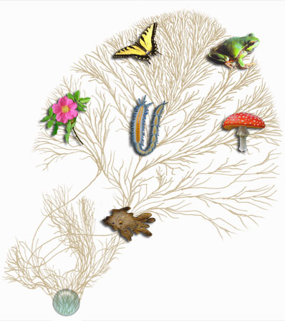
Classification & the New Taxonomy

Slide 2
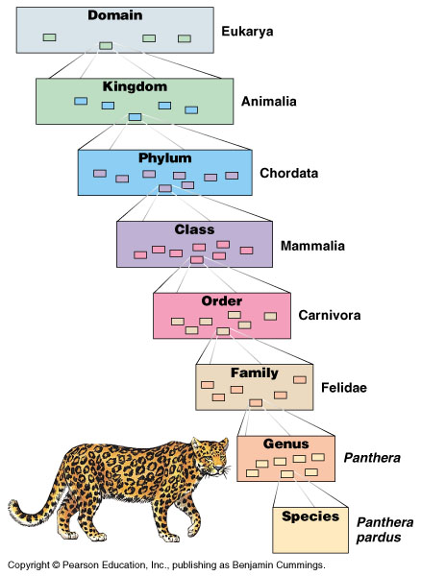
Finding commonality in variety
Organisms classified from most general group, domain, down to most specific, species
domain, kingdom, phylum, class, order, family, genus, species

Slide 3
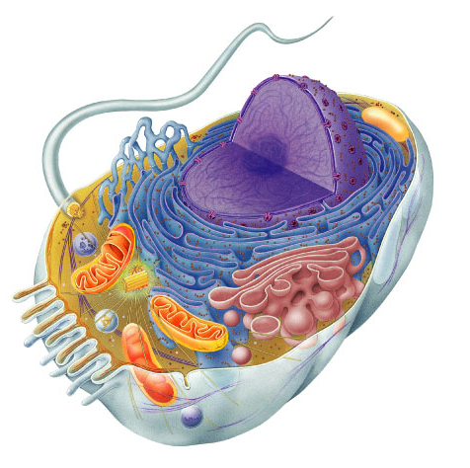
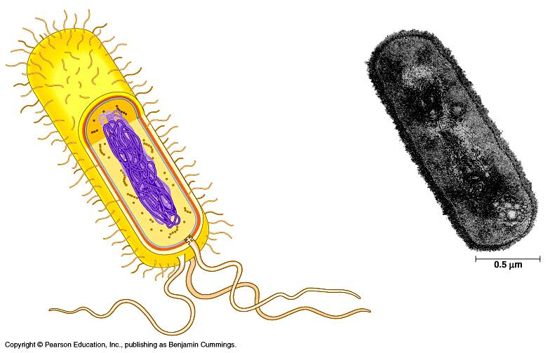
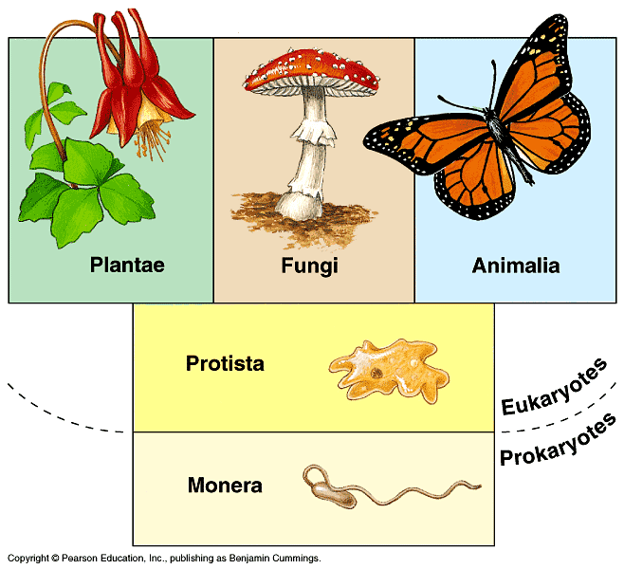
Classification
Eukaryote
Old 5 Kingdom system
Monera, Protists, Plants, Fungi, Animals
New 3 Domain system
reflects a greater understanding of evolution & molecular evidence
Prokaryote: Bacteria
Prokaryote: Archaebacteria
Eukaryotes
Protists
Plants
Fungi
Animals
Prokaryote
Archaebacteria & Bacteria

Slide 4
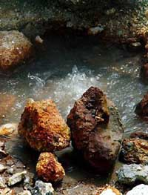
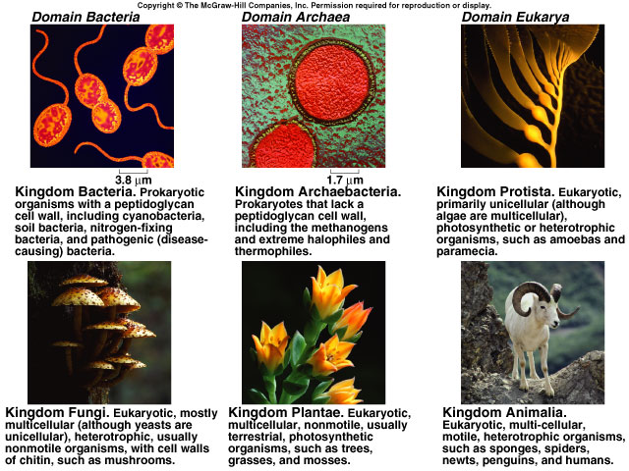
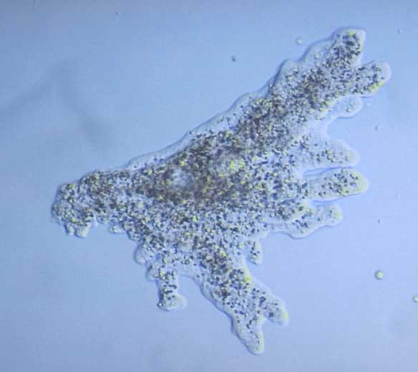
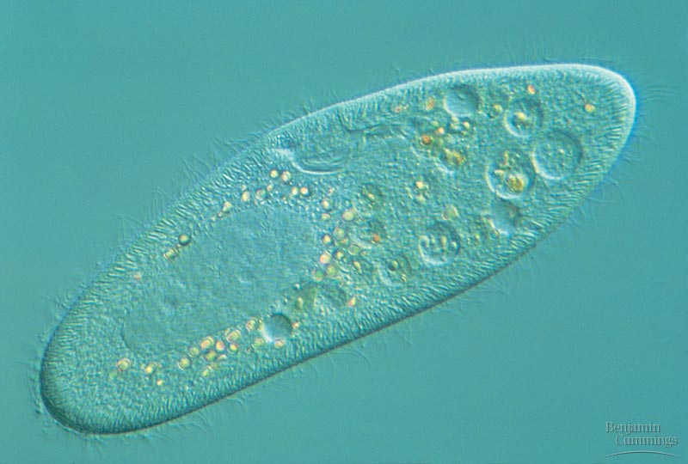
Kingdom Bacteria
Kingdom Archaebacteria
Kingdom Protist
Kingdom Fungi
Kingdom Plant
Kingdom Animal

Slide 5
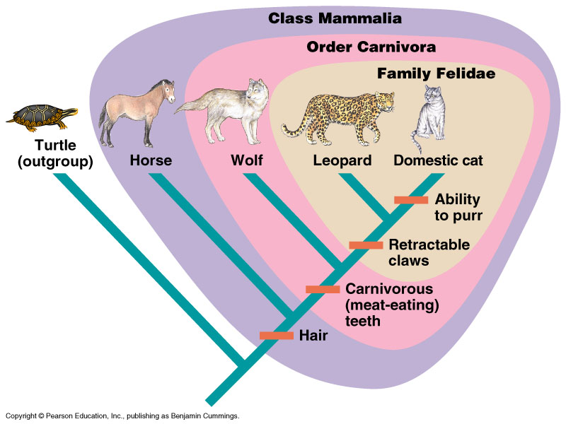
The Evolutionary Perspective

Slide 6
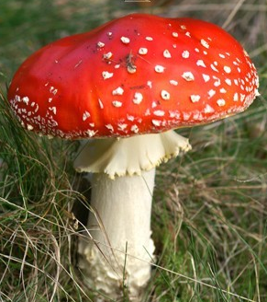
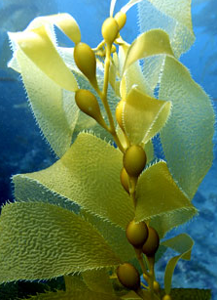
Kingdoms
Fungi
Animalia
absorptive nutrition
ingestive nutrition
Plantae
autotrophs
heterotrophs
Protista
uni- to multicellular
multicellular
Eubacteria
Archaebacteria
prokaryotes
eukaryotes
Single-celled ancestor

Slide 7
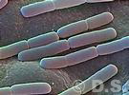
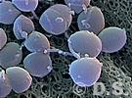
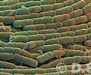
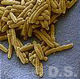
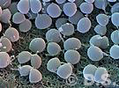
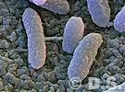
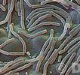
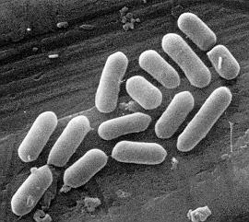
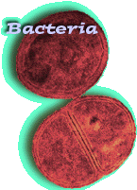
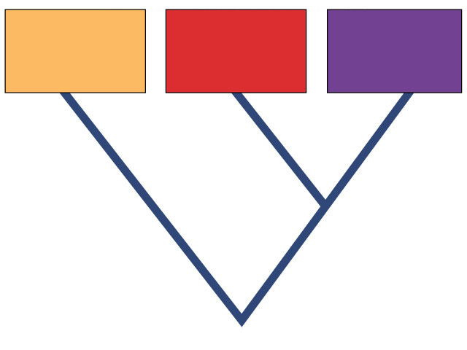
Prokaryotes
Domain Bacteria
Domain Archaebacteria
Domain
Bacteria
Domain
Archaea
Domain
Eukarya
Common ancestor

Slide 8
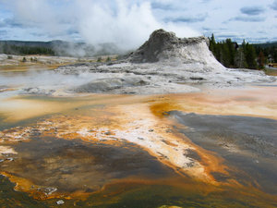
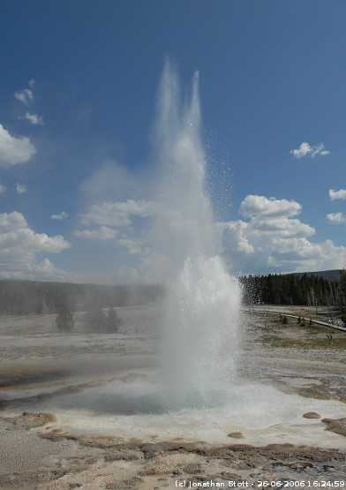
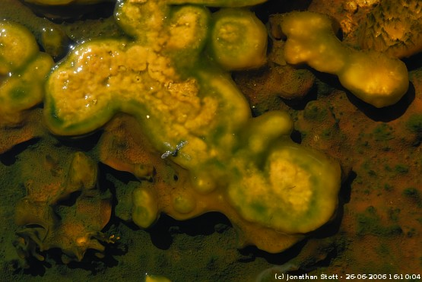
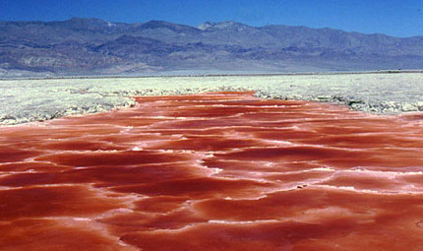
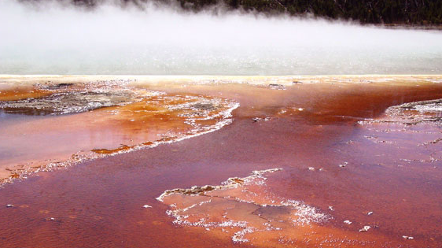
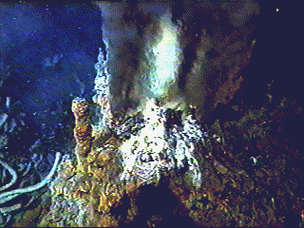
Bacteria live EVERYWHERE!
Bacteria live in all ecosystems
on plants & animals
in plants & animals
in the soil
in depths of the oceans
in extreme cold
in extreme hot
in extreme salt
on the living
on the dead
Microbes always find a way to make a living!

Slide 9
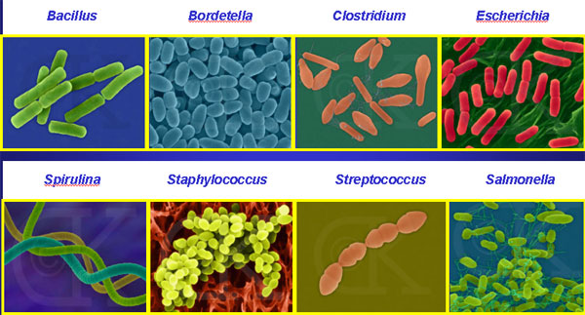
Bacterial diversity
rods and spheres and spirals… Oh My!
Notes:
Bacillus = anthrax, BT
Bordetella = pertussis or whooping cough, kennel cough
Clostridium = botulism & tetanus
Escherichia = E. coli
Spirulina = blue-gren algae
Staph
Strep
Salmonella

Slide 10
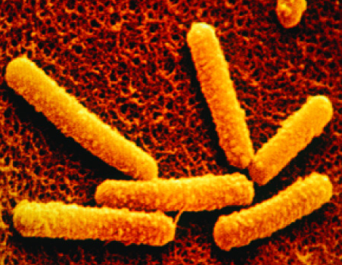
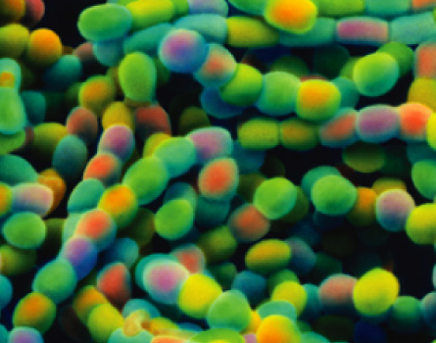
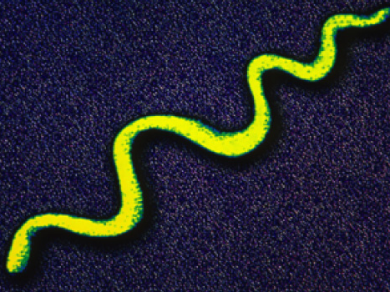
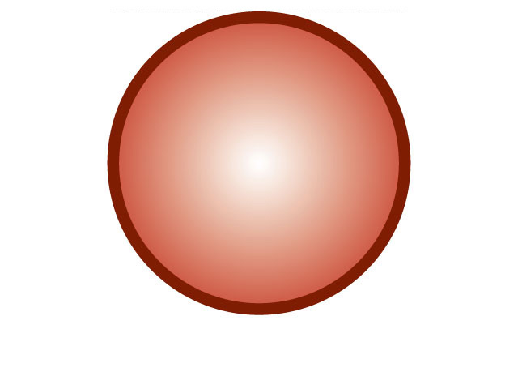
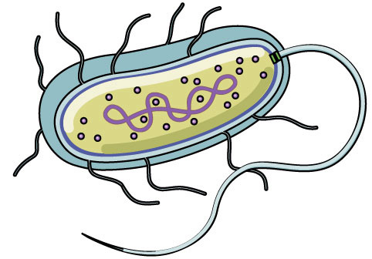
Prokaryote Structure
eukaryote cell
prokaryote cell
Unicellular
bacilli, cocci, spirilli
Size
1/10 size of eukaryote cell
1 micron (1um)
Internal structure
no internal compartments
no membrane-bound organelles
only ribosomes
circular chromosome, naked DNA
not wrapped around proteins

Slide 11
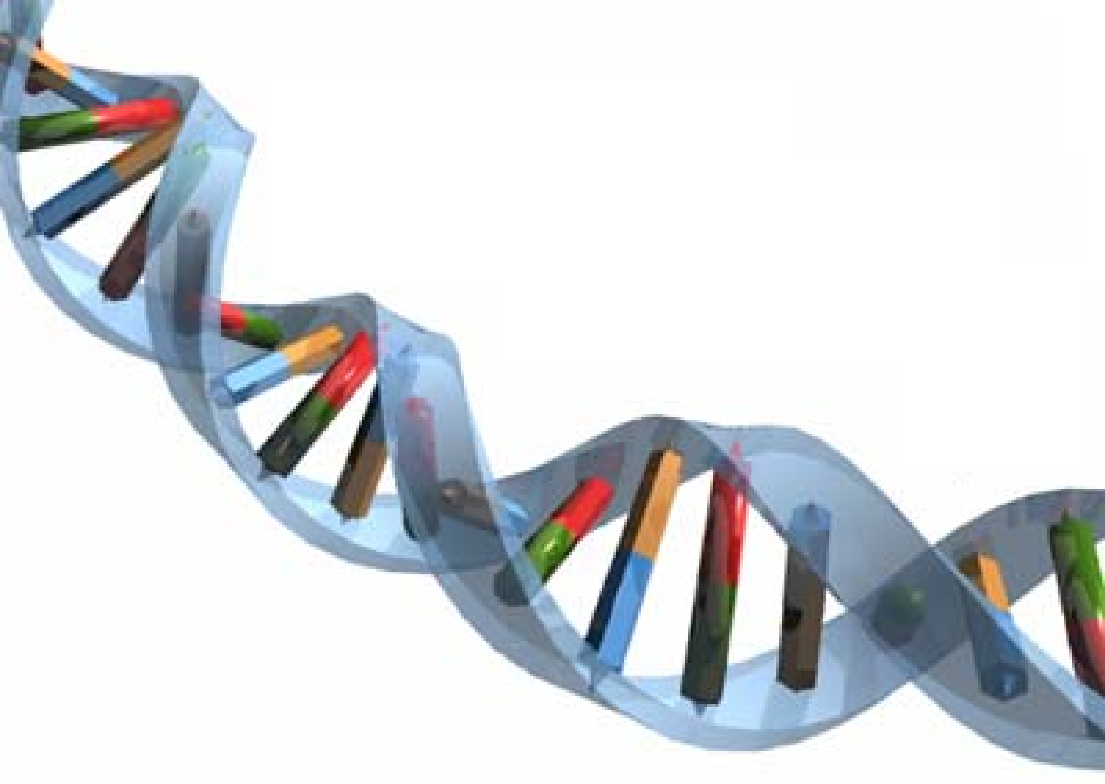
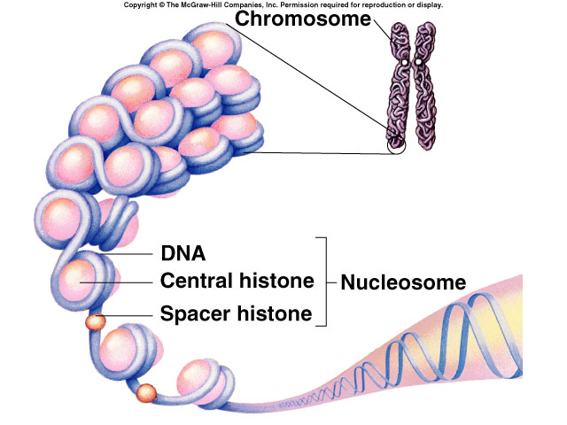
Prokaryote vs. Eukaryote Chromosome
Prokaryote
Eukaryote
double helix

Slide 12
Variations in Cell Interior
mitochondria
cyanobacterium (photosythetic) bacterium
aerobic bacterium
chloroplast
internal membranes for photosynthesis like a chloroplast (thylakoids)
internal membranes for respiration like a mitochondrion (cristae)

Slide 13
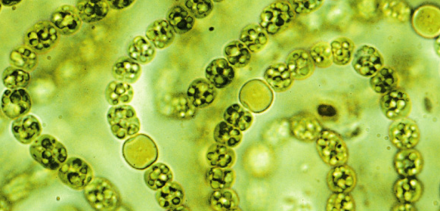
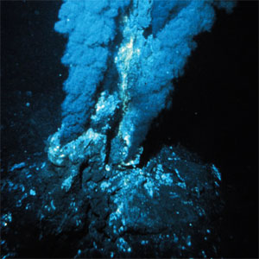
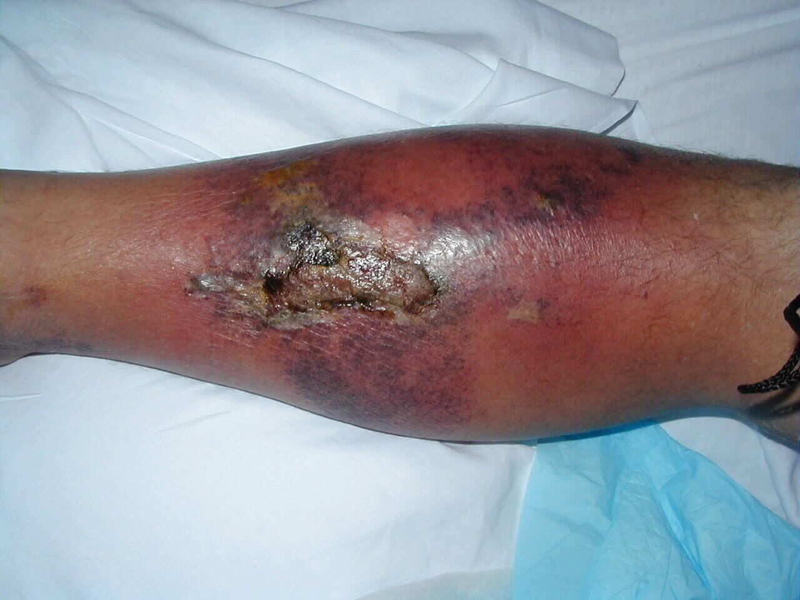
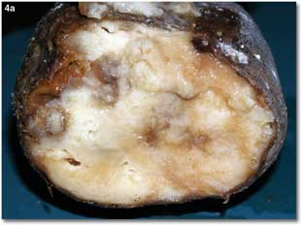
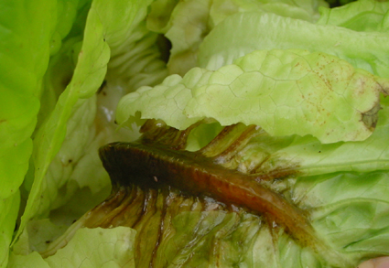
Prokaryotic metabolism
How do bacteria acquire their energy & nutrients?
photoautotrophs
photosynthetic bacteria
chemoautotrophs
oxidize inorganic compounds
nitrogen, sulfur, hydrogen…
heterotrophs
live on plant & animal matter
decomposers & pathogens

Slide 14
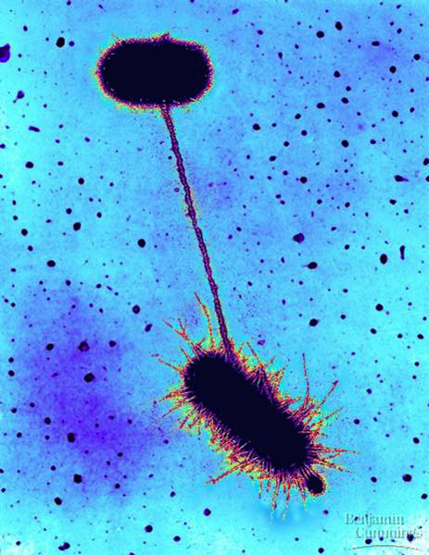
Genetic variation in bacteria
Mutations
bacteria can reproduce every 20 minutes
binary fission
error rate in copying DNA
1 in every 200 bacteria has a mutation
you have billions of E. coli in your gut!
lots of mutation potential!
Genetic recombination
bacteria swap genes
plasmids
small supplemental circles of DNA
conjugation
direct transfer of DNA
conjugation
Notes:
The adult human body contains an estimated 1 * 10^14 cells (a 1 followed by 14 zeros), 10% of which actually belong to us!! Thus, we have roughly 10 times more cells living in us than we do cells that make up our own bodies. Most of these 'outside' cells are bacteria living in the gastrointestinal tract. More than 400 species of microbes live in the colon alone, and can reach a density of 1 * 10^11 organism per milliliter of 'intestinal lumenal contents.'
Direct transfer of DNA between 2 bacterial cells that are temporarily joined
results from presence of F plasmid with F factor
F for “fertility” DNA
E. coli “male” extends sex pilli, attaches to female bacterium
cytoplasmic bridge allows transfer of DNA

Slide 15
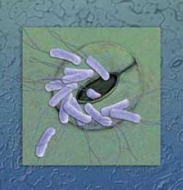
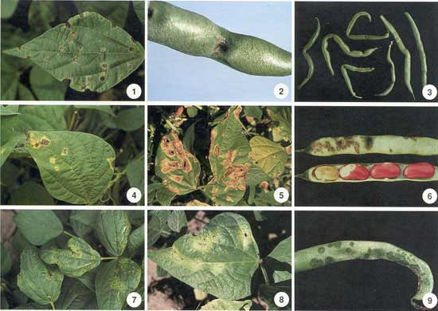
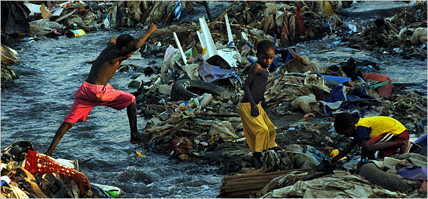
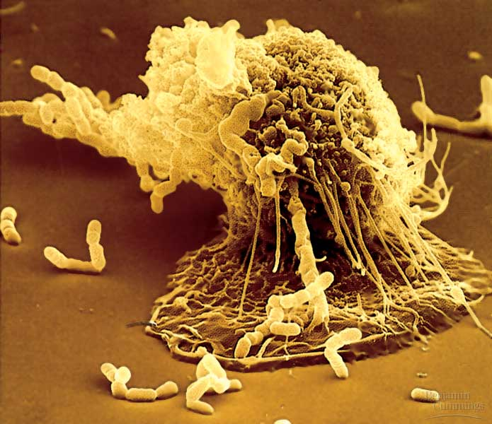
Bacteria as pathogens
Disease-causing microbes
plant diseases
wilts, fruit rot, blights
animal diseases
tooth decay, ulcers
anthrax, botulism
plague, leprosy, “flesh-eating” disease
STDs: gonorrhea, chlamydia
typhoid, cholera
TB, pneumonia
lyme disease

Slide 16
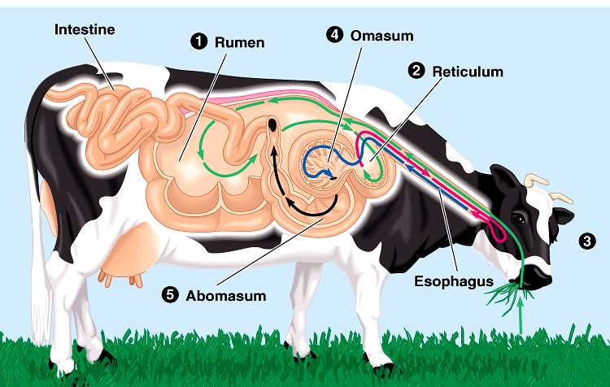
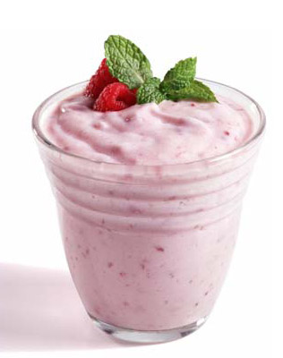
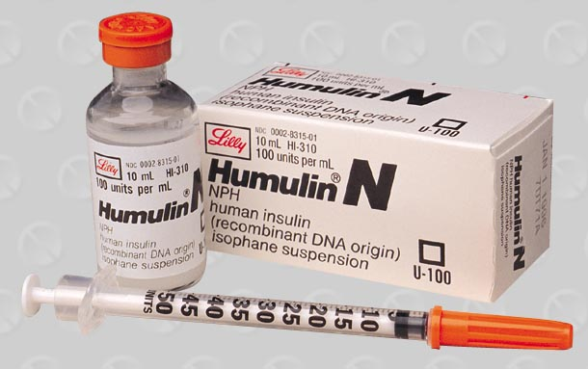
Bacteria as beneficial (& necessary)
Life on Earth is dependent on bacteria
decomposers
recycling of nutrients from dead to living
nitrogen fixation
only organisms that can fix N from atmosphere
needed for synthesis of proteins & nucleic acids
plant root nodules
digest cellulose (E. coli)
digest cellulose for herbivores
cellulase enzyme
produce vitamins K & B₁₂ for humans
produce foods & medicines
from yogurt to insulin

Slide 17
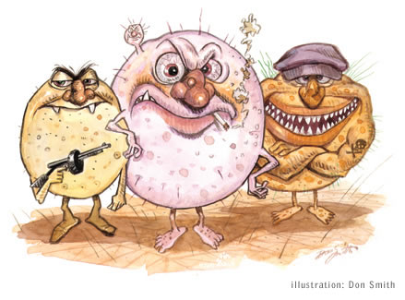
Got any Questions??
Ask da’ Bacterial Boss!
You may stop here.

Slide 18
Prokaryote Cell Wall Structure
Gram-positive bacteria
peptide side
chains
cell wall
peptidoglycan
plasma membrane
That’s important for your doctor to know!
protein
peptidoglycan = polysaccharides + amino acid chains
lipopolysaccharides = lipids + polysaccharides
Gram-negative bacteria
outer membrane of lipopolysaccharides
outer
membrane
cell wall
peptidoglycan
plasma
membrane
Notes:
Most pathogenic bacteria in humans are gram-negative organisms.
Escherichia coli, Salmonella, and other Enterobacteriaceae, Pseudomonas, Moraxella, Helicobacter, Stenotrophomonas, Legionella and Wolbachia and many others, cyanobacteria, spirochaetes, green sulfur and green non-sulfur bacteria.
Medically relevant Gram-negative cocci include three organisms, which cause a sexually transmitted disease (Neisseria gonorrhoeae), a meningitis (Neisseria meningitidis), and respiratory symptoms (Moraxella catarrhalis).
Medically relevant Gram-negative bacilli include a multitude of species. Some of them primarily cause respiratory problems (Hemophilus influenzae, Klebsiella pneumoniae, Legionella pneumophila, Pseudomonas aeruginosa), primarily urinary problems (Escherichia coli, Proteus mirabilis, Enterobacter cloacae, Serratia marcescens), and primarily gastrointestinal problems (Helicobacter pylori, Salmonella enteritidis, Salmonella typhi).
Classically, six gram-positive organisms are typically pathogenic in humans. Two of these, Streptococcus and Staphylococcus, are cocci (round bacteria). The remaining organisms are bacilli (rod-shaped bacteria) and can be subdivided based on their ability to form spores. The non-spore formers are Corynebacterium and Listeria (food poisoning w/ 25% mortality vs 1% in Salmonella), while Bacillus and Clostridium (botulism & tetanus) produce spores. The spore-forming bacteria can again be divided based on their respiration: Bacillus is a facultative anaerobe, while Clostridium is an obligate anaerobe.

